Slide 1
Visualization of Live Transportation Data
James Black
Ramsey Magana
Aniruddh Nautiyal
Rich Ung

Slide 2
Project Goal
Purpose: Our group is most interested in exploring how to process and visualize streaming data. Our goal was to use Transport for London’s (TfL) live streaming transportation, create a live representation of their transportation network, and visualize London transportation in relation to joint socioeconomic datasets.

Slide 3
Project Update
As we continued with our project, we realized that TfL did not contain the data we were looking for, so we moved to an alternate streaming data source: San Francisco transportation data!
511 SF Bay contains many different APIs to pull data about their vehicles.
http://511.org/developers/list/apis/

Slide 4
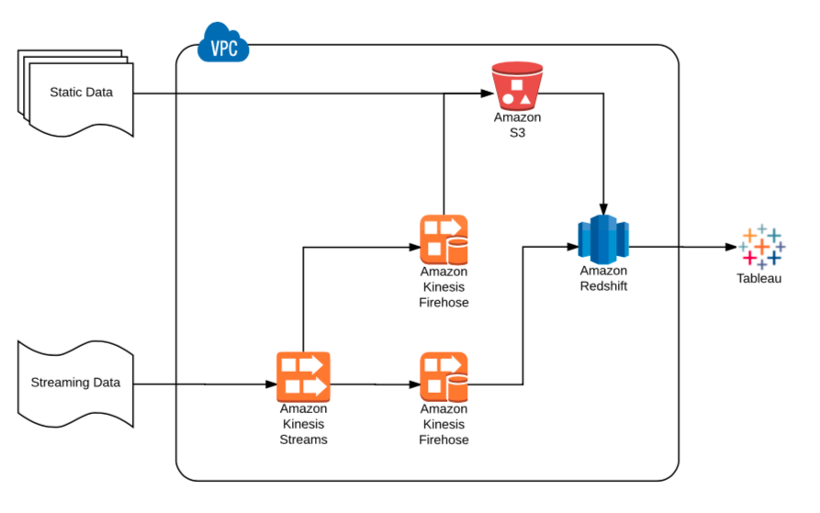
Data Architecture Overview

Slide 5
Data Architecture Layers
Processing Layers
Python scripts and Amazon Kinesis Firehose
Service Layer
Amazon Redshift
Data Ingest Layer
Python scripts via Amazon Lambda, and Amazon Kinesis Stream

Slide 6
Data Architecture
Static data is stored directly into S3
Another script loads data from S3 into Redshift
Streaming data is sent to Kinesis, where it’s handled up by two delivery streams
One delivery stream sends streaming data to S3 for historical storage
One delivery stream sends streaming data to Redshift for immediate analysis
Redshift data is analyzed via Tableau

Slide 7
Benefits
Scalability
All data is stored in S3 (scales out)
Add/remove shards from Kinesis Data Stream to allow for more/less bandwidth (scales out)
Additional Processing
Can be done through Kinesis Firehose, or Spark Streaming (which also scales out)
Less Server Management
No need to have a server instance to store historical data (historical data is in S3)

Slide 8
Data Sources
Streaming live data feeds (511.org)
Crime data (sfgov.org)
Income data (irs.gov)

Slide 9
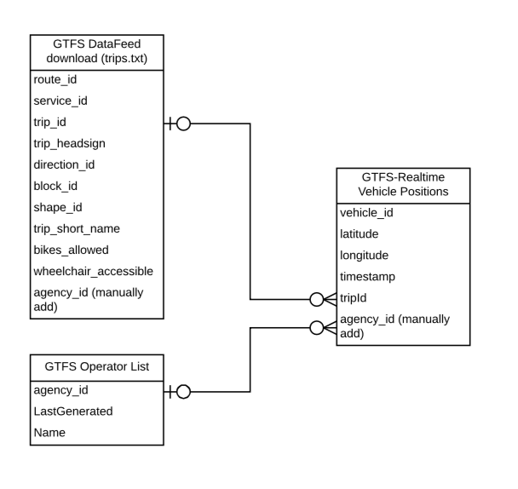
ER Diagram

Slide 10
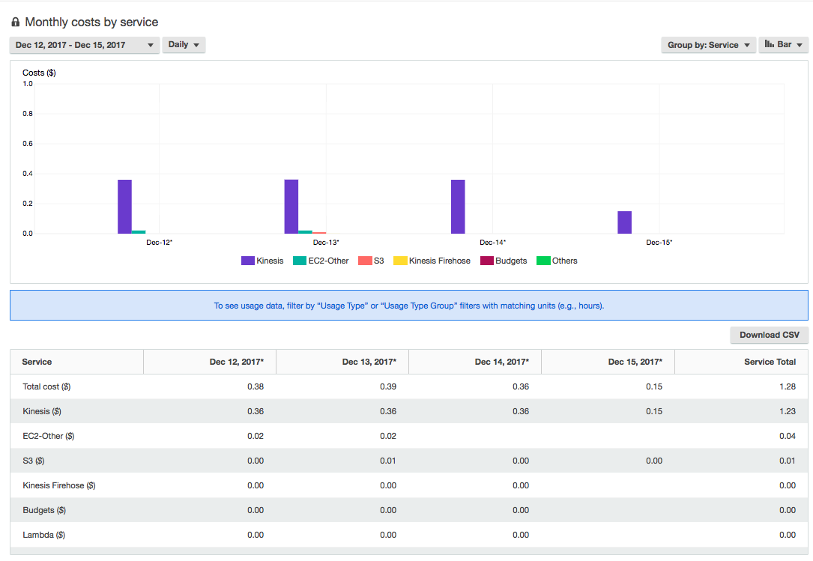
Estimated Cost
We were using a free trial of Redshift. Without it, it would be about $0.25 /hr/node (as of now), or $6 per day for one Redshift dc2large node.

Slide 11
Additional Scaling Options
Joins are performed on the Redshift database
Joins can be expensive with large datasets
Can optimize query, or perform join as the data is flowing in through Spark Streaming
S3 buffering
A file is created every 60 seconds or 300 seconds
This causes a lot of files to be created, increasing IOPS
Reassess the desired measurement or ingestion period
Unpartitioned tables
Table columns could be partitioned for better access
Streaming live feed data polling
The 511.org API has a limit of 60 requests /hr. This can
be a limiting factor if finer granularity is needed.
Notes:
Streaming API limitation even after rotating 4 API keys of the group

Slide 12
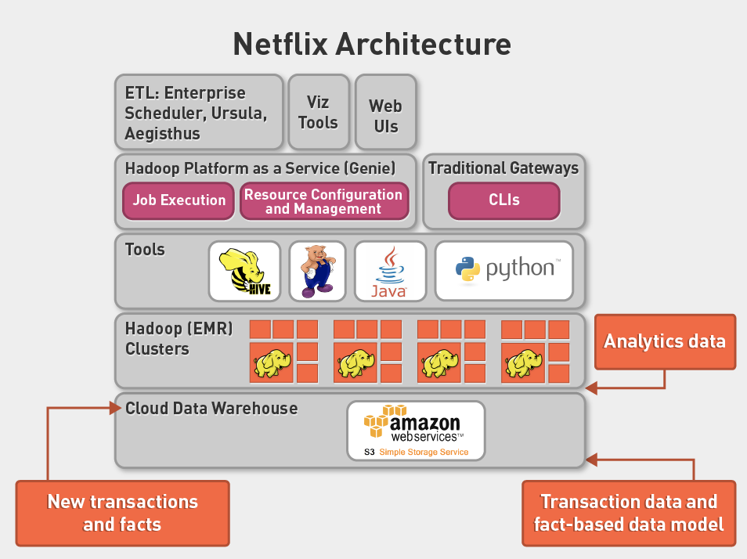
Future Roadmap
All static and historical streaming data is stored onto S3
We can analyze that S3 data using Spark
Combine historical S3 data and streaming Kinesis data to create new streaming datasets using Spark Streaming
Netflix Architecture (4.5 High-Level Architectures Async Material)

Slide 13
Learning feedback
Be adaptable to new datasets
Our intended dataset lacked key/desired values (e.g. vehicle positions), so we had to decide to switch to an alternate data source
Be adaptable to new technologies
We originally planned on an Apache Metron deployment, but realized that wasn’t ideal and decided to switch architectures

Slide 14
Live Demonstration

Slide 15
THANKS!
Questions?

